Slide 1


Tahmid S
2022-07-06

Slide 2

Outline
Executive Summary
Introduction
Methodology
Results
Conclusion
Appendix

Slide 3
Executive Summary
Summary of methodologies
- Data collection and web scraping
- EDA involving data wrangling, data visualization, SQL and interactive visual analytics
- Location site visualization
- Machine learning predictions
Summary of all results
Real time data collected from SpaceX API
Machine learning predictions displayed best model in terms of feature engineering and feature selection

Slide 4
Introduction
Project background and context
- The purpose of this initiative was to evaluate how SpaceY would compete with SpaceX
Problems you want to find answers
Best places to make SpaceY launches
Estimating total cost for launches
Predicting landing sites and visualizations

Slide 5

Section 1

Slide 6
Methodology
Executive Summary
Data collection methodology:
SpaceX API
Web Scraping in python
Perform data wrangling
Data collected was combined with landing outcomes and additional features
Perform exploratory data analysis (EDA) using visualization and SQL
Perform interactive visual analytics using Folium and Plotly Dash
Perform predictive analysis using classification models

Slide 7
Data Collection
SpaceX API
Web scraping

Slide 8
Data Collection – SpaceX API
SpaceX API request for launch datasets
Github URL of SpaceX API calls notebook: https://github.com/tahmid-s99/Applied-DataScience-Project/blob/main/Data_Collection_API.ipynb
Filtering data for only Falcon 9 launches
Preprocessing and missing values

Slide 9
Data Collection - Scraping
Github URL of web scraping for launch data: https://github.com/tahmid-s99/Applied-DataScience-Project/blob/main/Data_Collection_Web_Scraping.ipynb
Request for Falcon 9 launch wiki page
Extracting columns/variables from HTML tags
DataFrame using launch HTML tables

Slide 10
Data Wrangling
EDA
Github URL for data wrangling: https://github.com/tahmid-s99/Applied-DataScience-Project/blob/main/Data_Wrangling.ipynb
Summary of data findings
Landmarks outcome labels

Slide 11
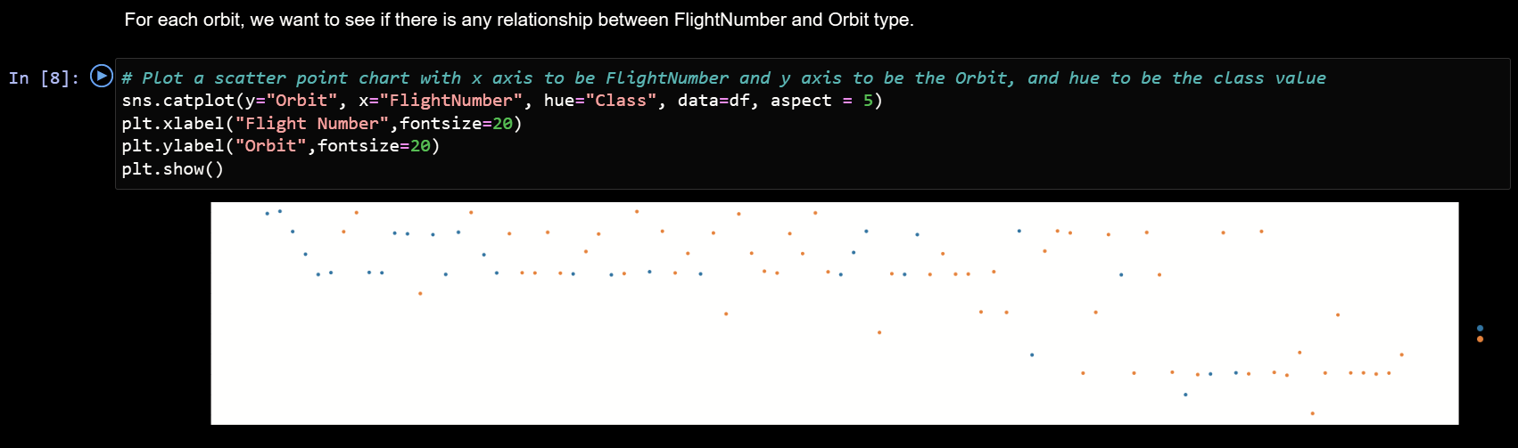
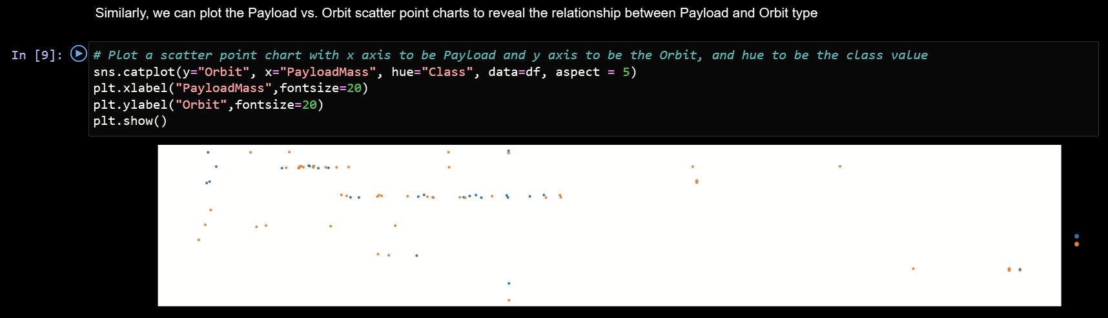
EDA with Data Visualization
Visualization of different pairs of features were done
Github URL of EDA for data visualization: https://github.com/tahmid-s99/Applied-DataScience-Project/blob/main/EDA_with_Visualization.ipynb

Slide 12
EDA with SQL
Following queries were performed:
Name of unique launch sites in mission
Top 5 launch sites with ‘CCA’ in their names
Average payload mass carried by boosters
First successful landing outcome
Names of boosters having success in drone ship and payload mass between 4000 and 6000 kg
Total successful and failure missions
Name of boosters having carried maximum payload mass
Failed landing outcomes
Rank of count of landing outcomes
Github URL of EDA with SQL: https://github.com/tahmid-s99/Applied-DataScience-Project/blob/main/EDA_with_SQL.ipynb

Slide 13
Build an Interactive Map with Folium
Markers, circles marker clusters and lines were used in Folium maps:
Markers indicated launch sites
Marker clusters indicated groups of events in different coordinates
Lines were used in indicating distance between coordinates
Circles indicated highlighted areas around coordinates
Github URL of Folium visualization: https://github.com/tahmid-s99/Applied-DataScience-Project/blob/main/Folium_Visualization.ipynb

Slide 14
Build a Dashboard with Plotly Dash
Percentage of launches by site and payload range was usd in Plotly Dashboard
We can quickly find relationships between payloads and launch sites
Github URL of Plotly Dash Dashboard: https://github.com/tahmid-s99/Applied-DataScience-Project/blob/main/spacex_dash_app.py

Slide 15
Predictive Analysis (Classification)
Different classification models were performed: Logistic regression, SVM, Decision Tree, KNN
Github URL of ML Predictive Analysis: https://github.com/tahmid-s99/Applied-DataScience-Project/blob/main/SpaceX_ML_Prediction.ipynb
Data preprocessing and standardization
Testing of model combinations and hyperparameters
Results and findings

Slide 16
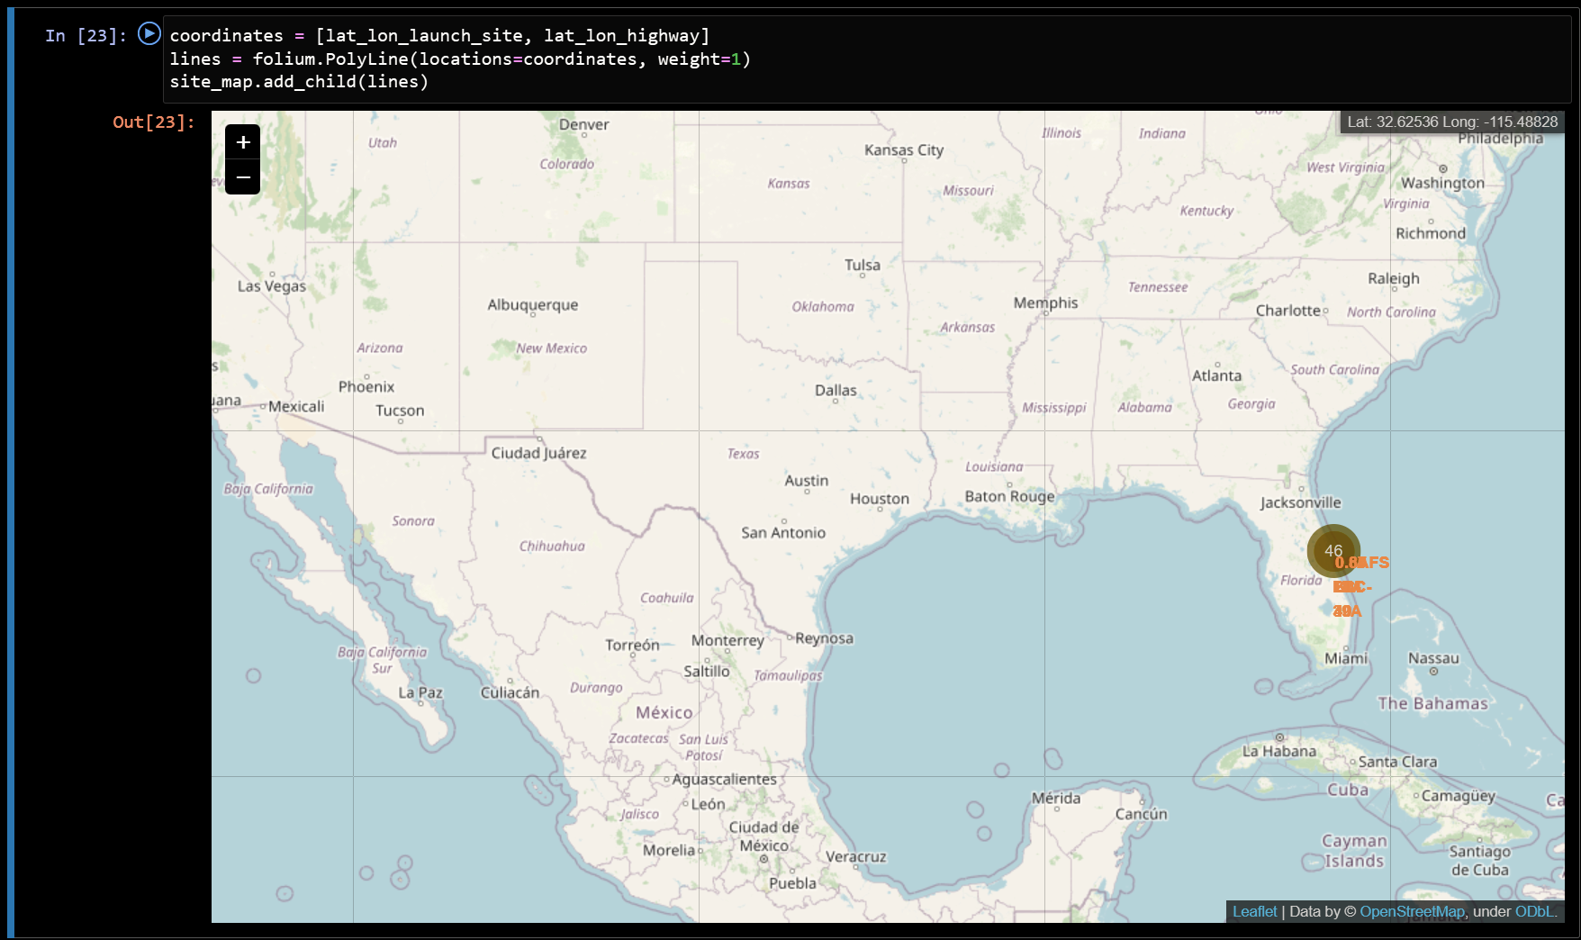
Results
Utilizing interactive analytics made it possible to identify launch sites used for satefy, near sea and other locations

Slide 17

Section 2

Slide 18
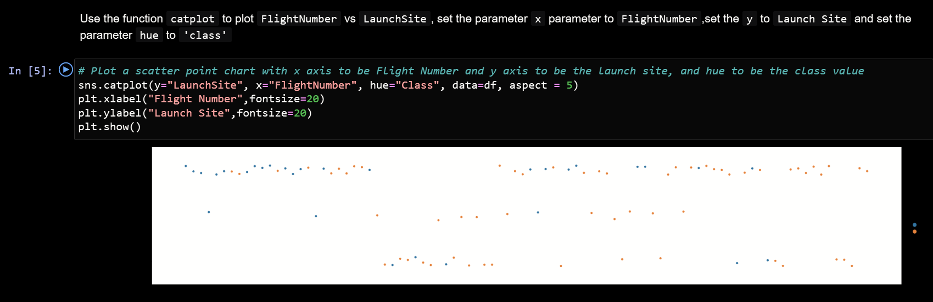
Flight Number vs. Launch Site
The best launch site seems to be CCAFS SLC 40
The general success rate of launches improved over time

Slide 19
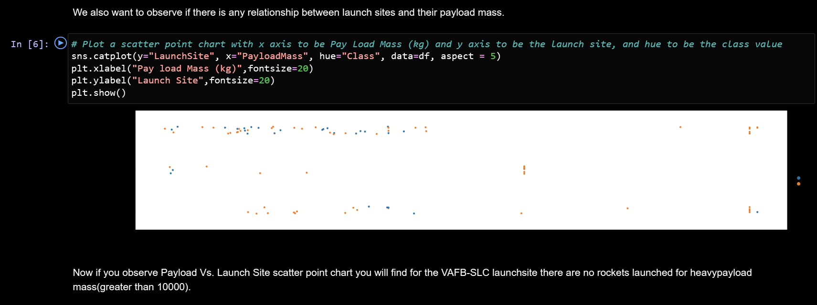
Payload vs. Launch Site
Payloads over 9000 kg have good success rates whereas payloads over 12000 kg are only possible on the launch sites CCAFS SLC 40 and KSC LC 39A

Slide 20
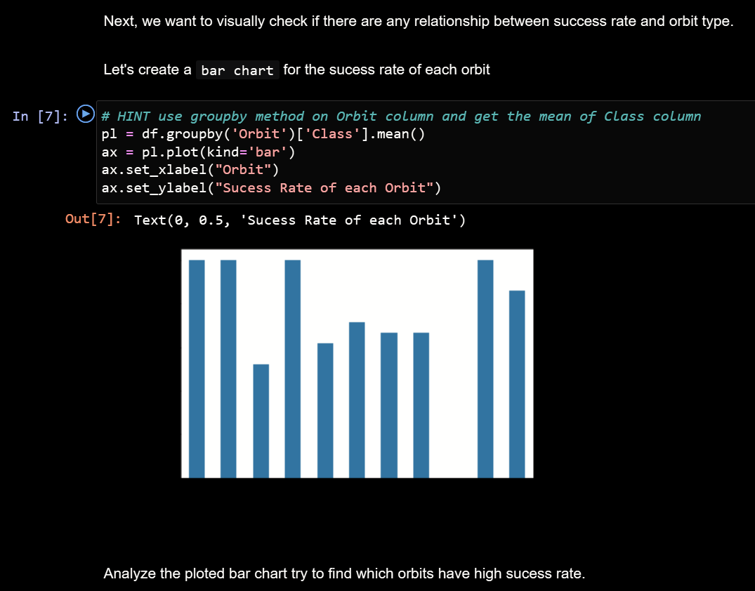
Success Rate vs. Orbit Type
The biggest success rates occurs for:
ES-L1
GEO
HEO
SSO

Slide 21
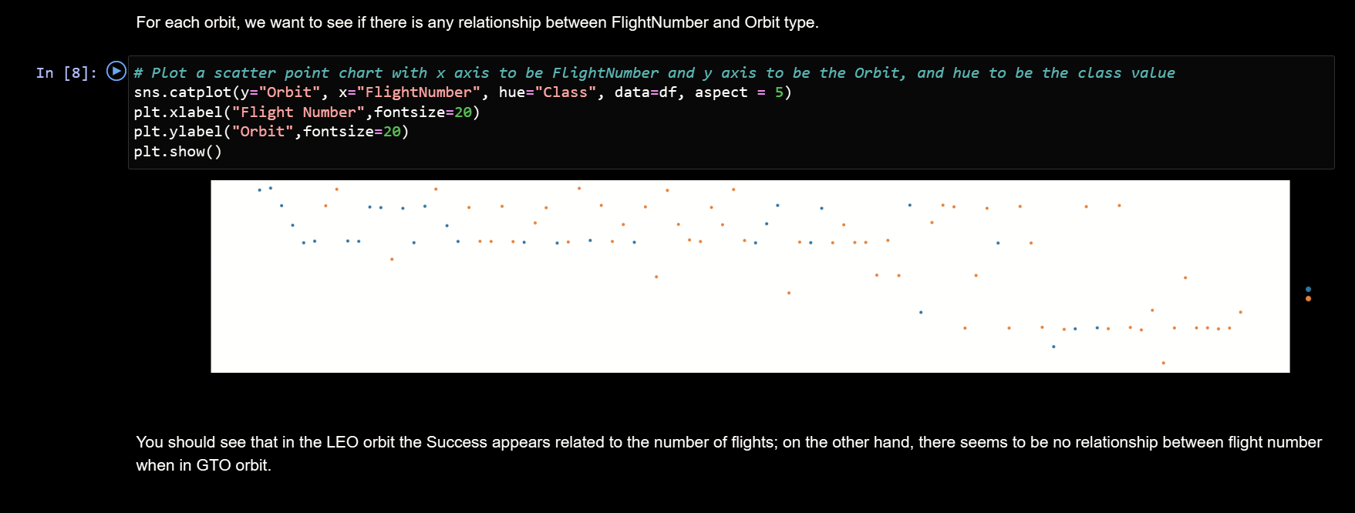
Flight Number vs. Orbit Type
Success rate improves over time for all orbits
VLEO orbit increases in its frequency for successes

Slide 22
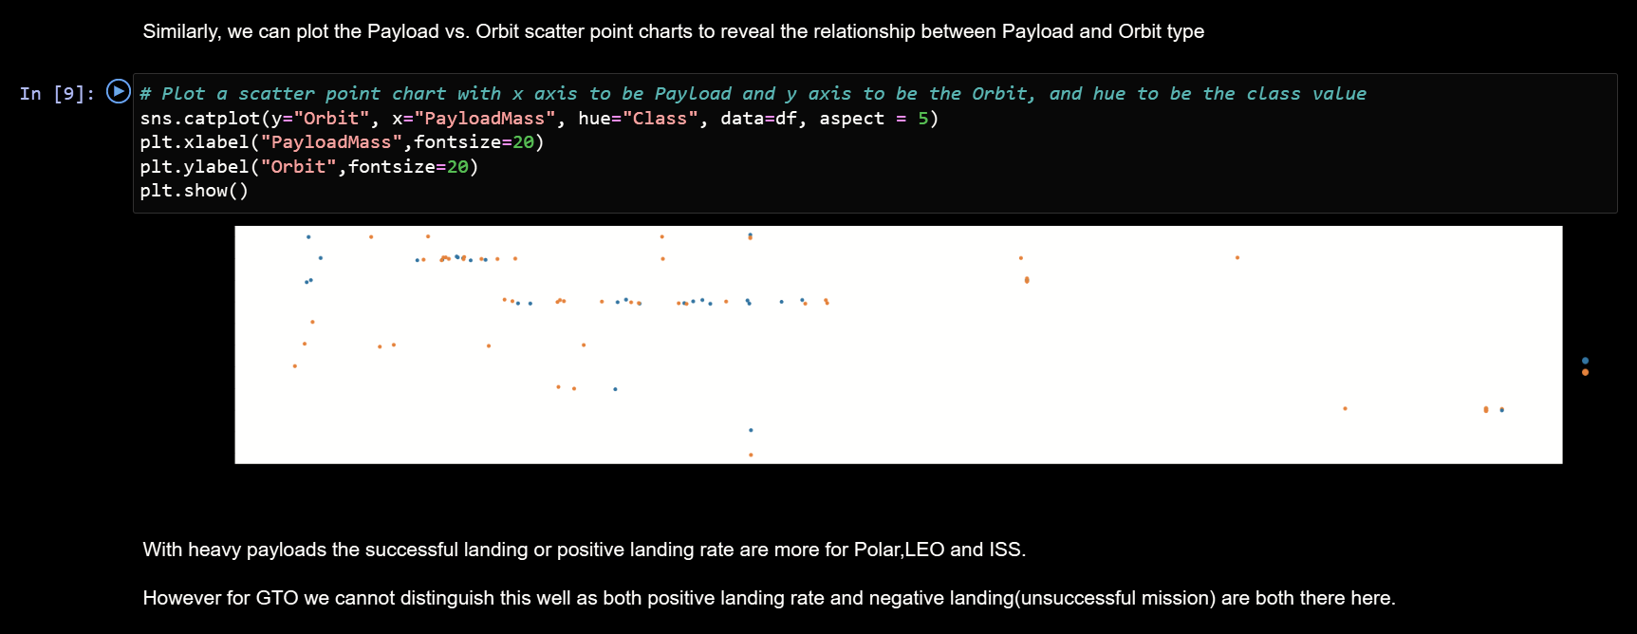
Payload vs. Orbit Type
No defined relationship between payload and orbit type

Slide 23
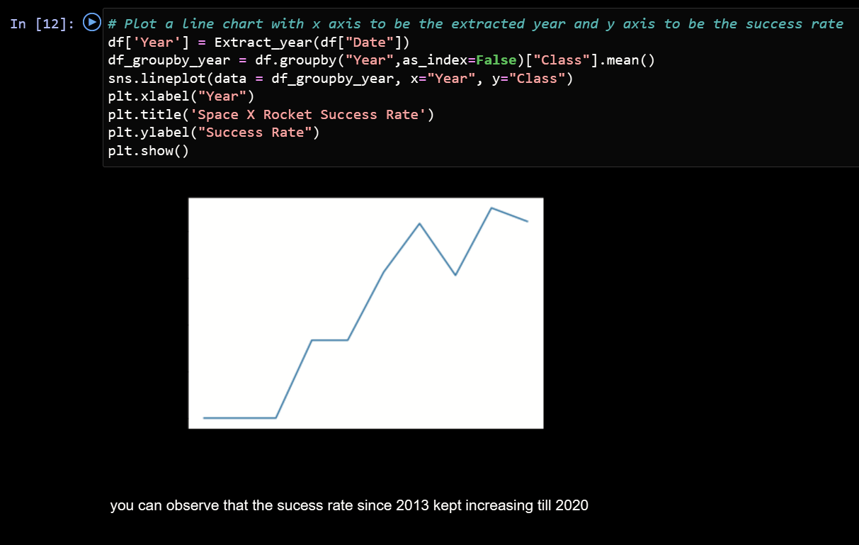
Launch Success Yearly Trend
Success rate over time shows an increasing trend from 2013 until 2020

Slide 24
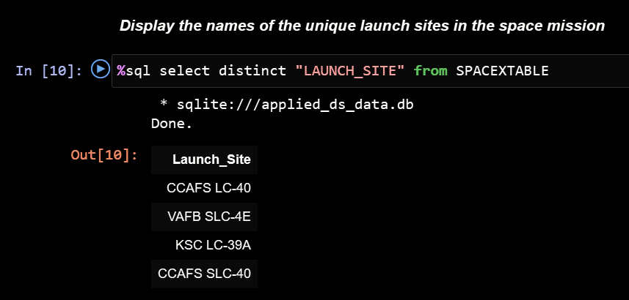
All Launch Site Names
There are mainly 4 below launch sites

Slide 25
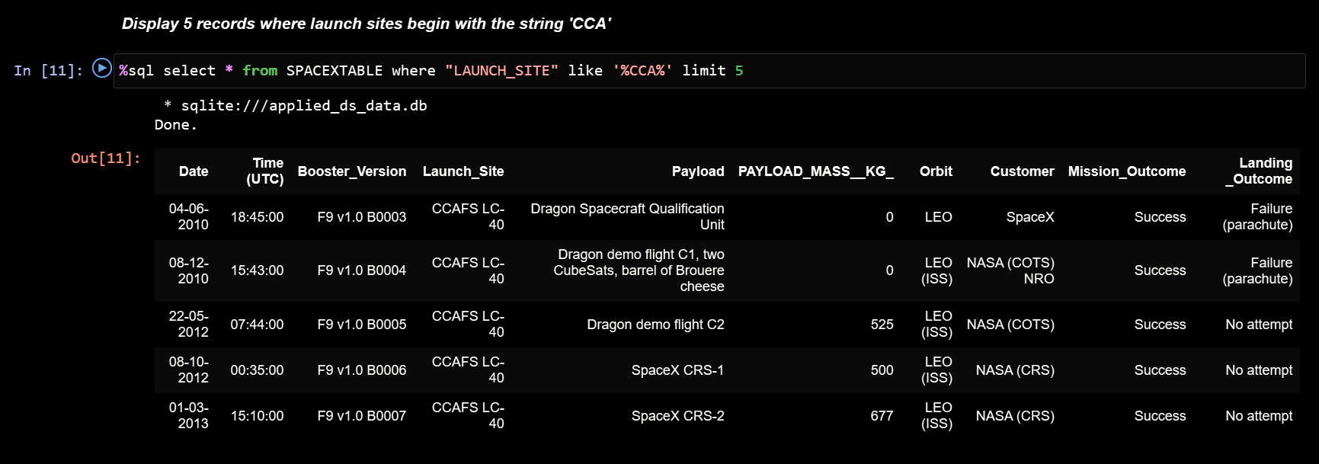
Launch Site Names Begin with 'CCA'
Below 5 launch sites start with ‘CCA’

Slide 26
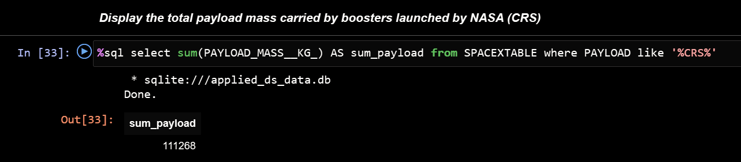
Total Payload Mass
The total sum of payload is 111.268 kg.

Slide 27
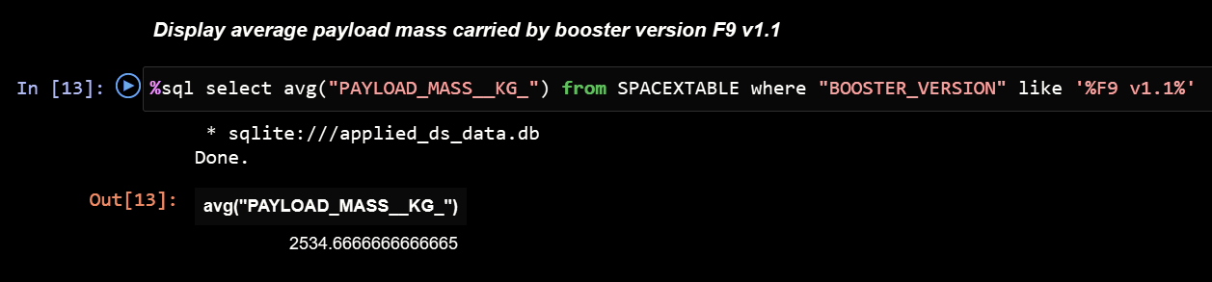
Average Payload Mass by F9 v1.1
The average payload mass carried by booster version F9 v1.1 is below.

Slide 28
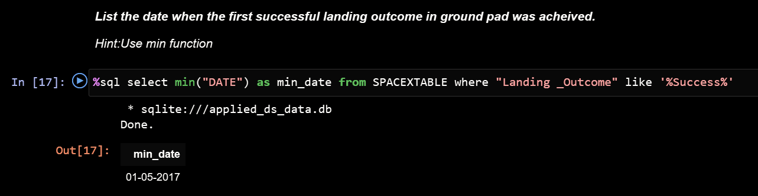
First Successful Ground Landing Date
The first successful ground landing date is shown below:

Slide 29
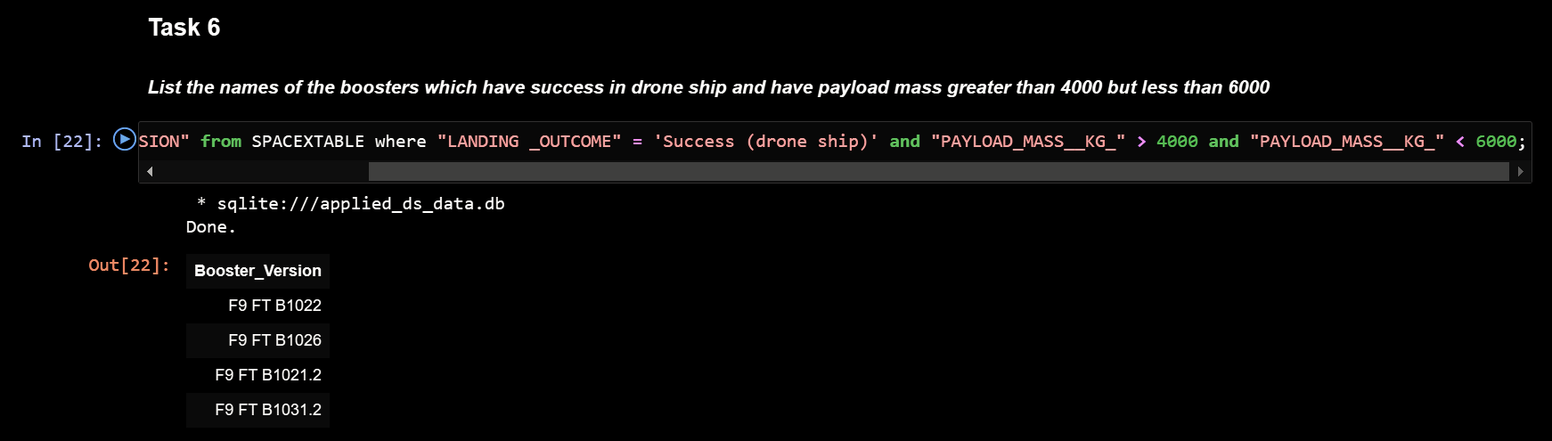
Successful Drone Ship Landing with Payload between 4000 and 6000
All names of boosters which have successfully landed on drone ship and had payload mass greater than 4000 but less than 6000:

Slide 30
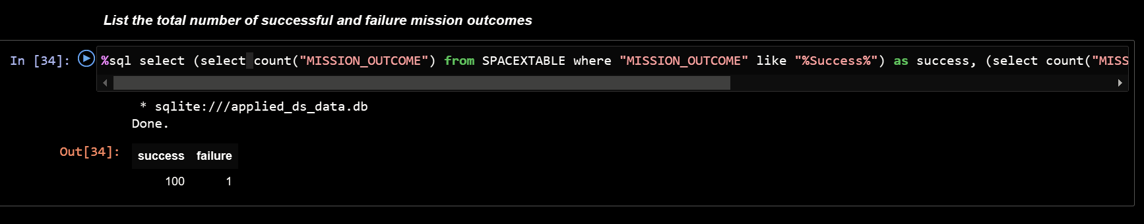
Total Number of Successful and Failure Mission Outcomes
Total number of successful and failure mission outcomes

Slide 31
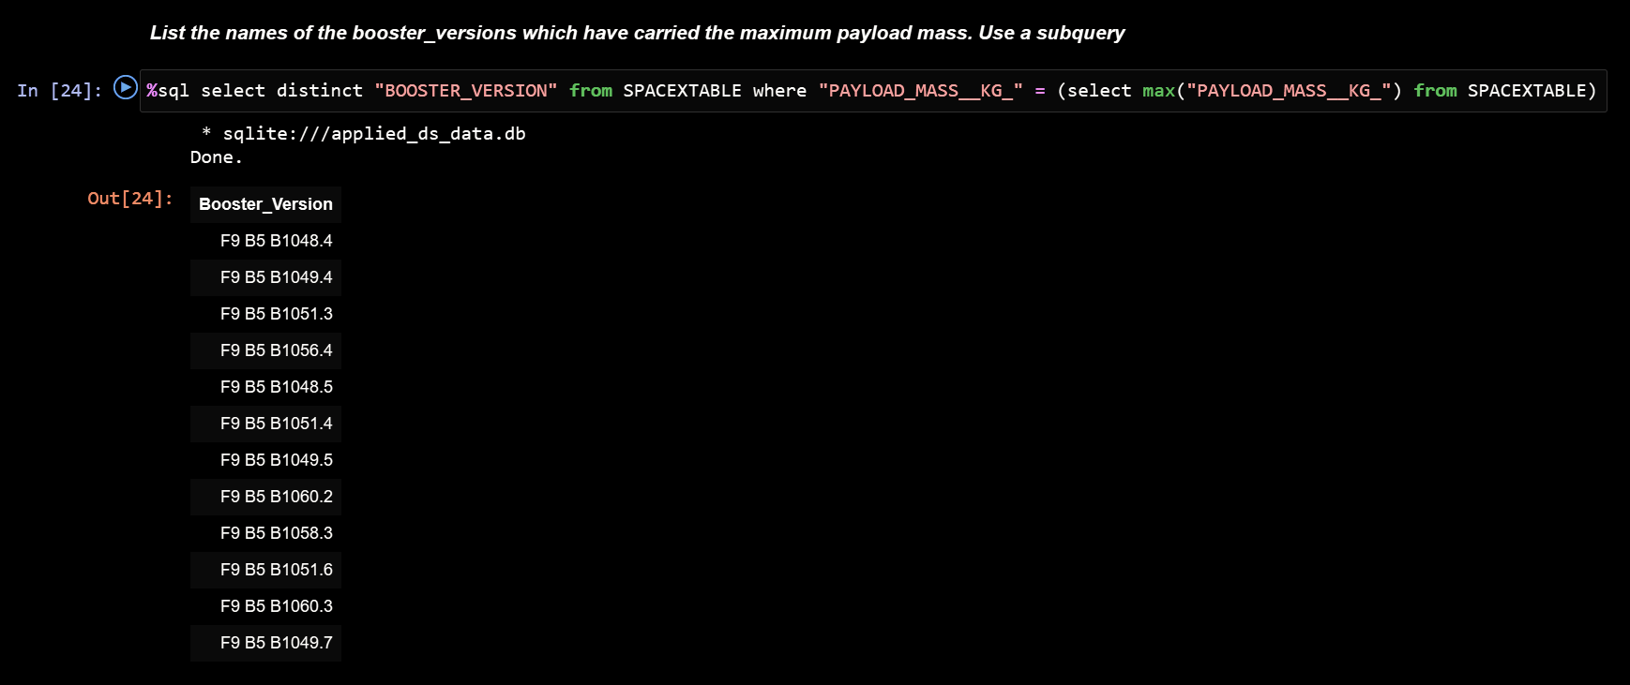
Boosters Carried Maximum Payload
Boosters carrying the maximum payload mass:

Slide 32
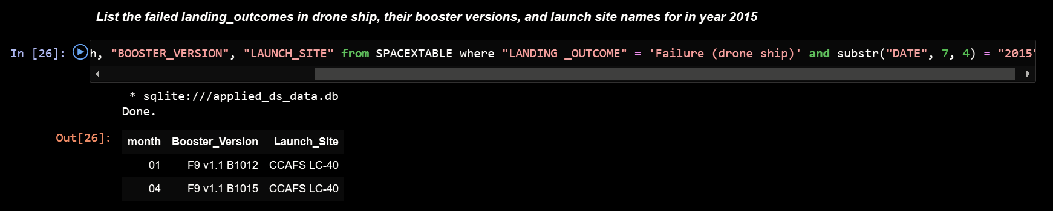
2015 Launch Records
Failed landing outcomes in drone ship in the year 2015 (there are two occurrences):

Slide 33
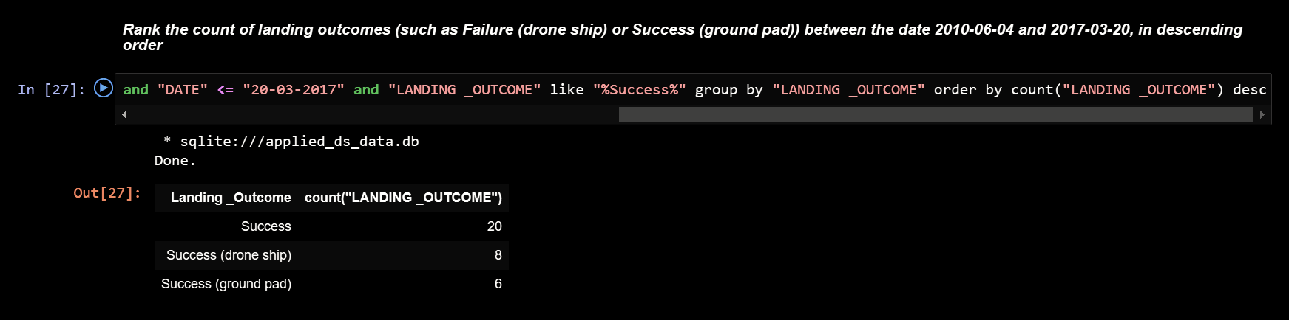
Rank Landing Outcomes Between 2010-06-04 and 2017-03-20
Ranking the count of successes and landing outcomes between 2010-06-04 and 2017-03-20:

Slide 34

Section 3

Slide 35
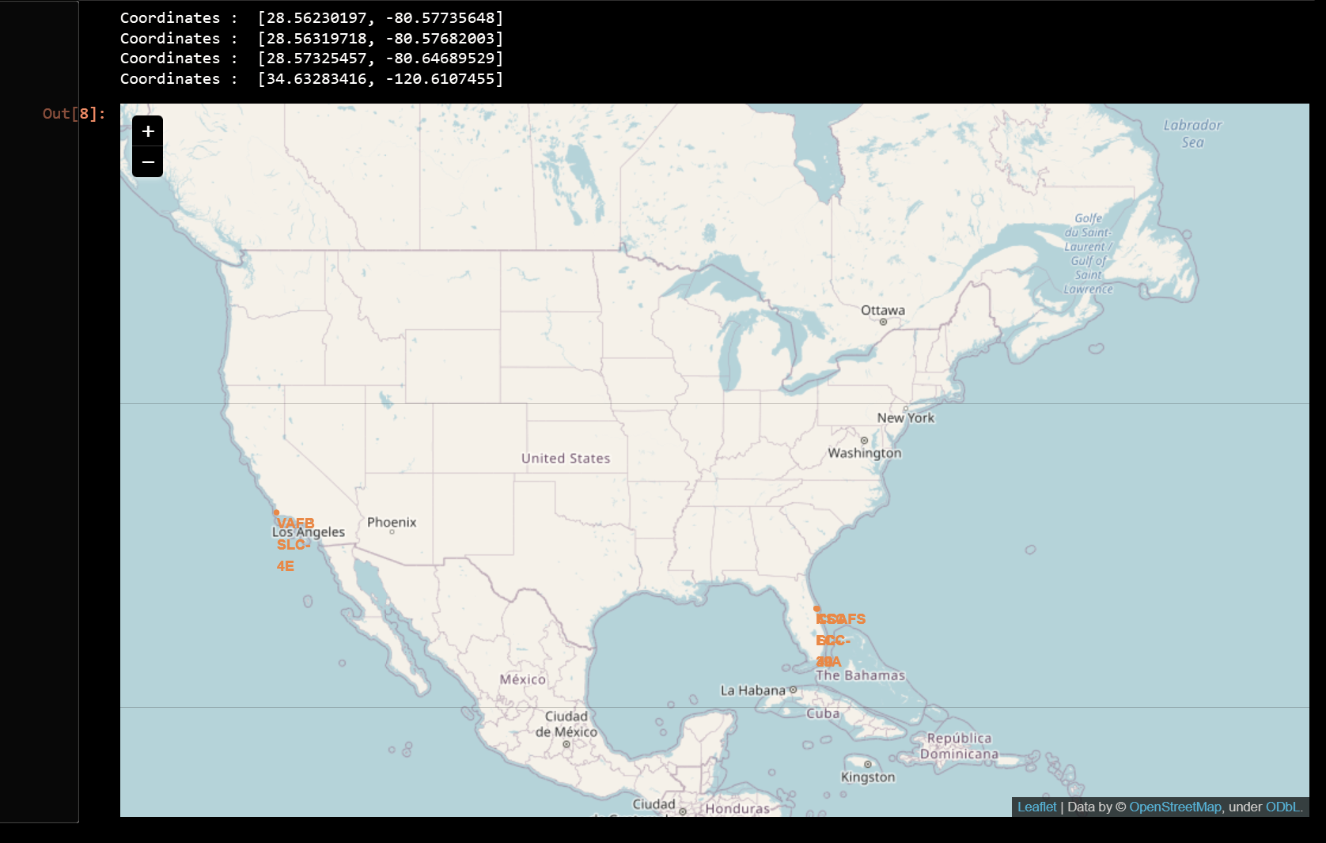
Map of all launch sites
All launch sites near sea, away from main land areas:

Slide 36
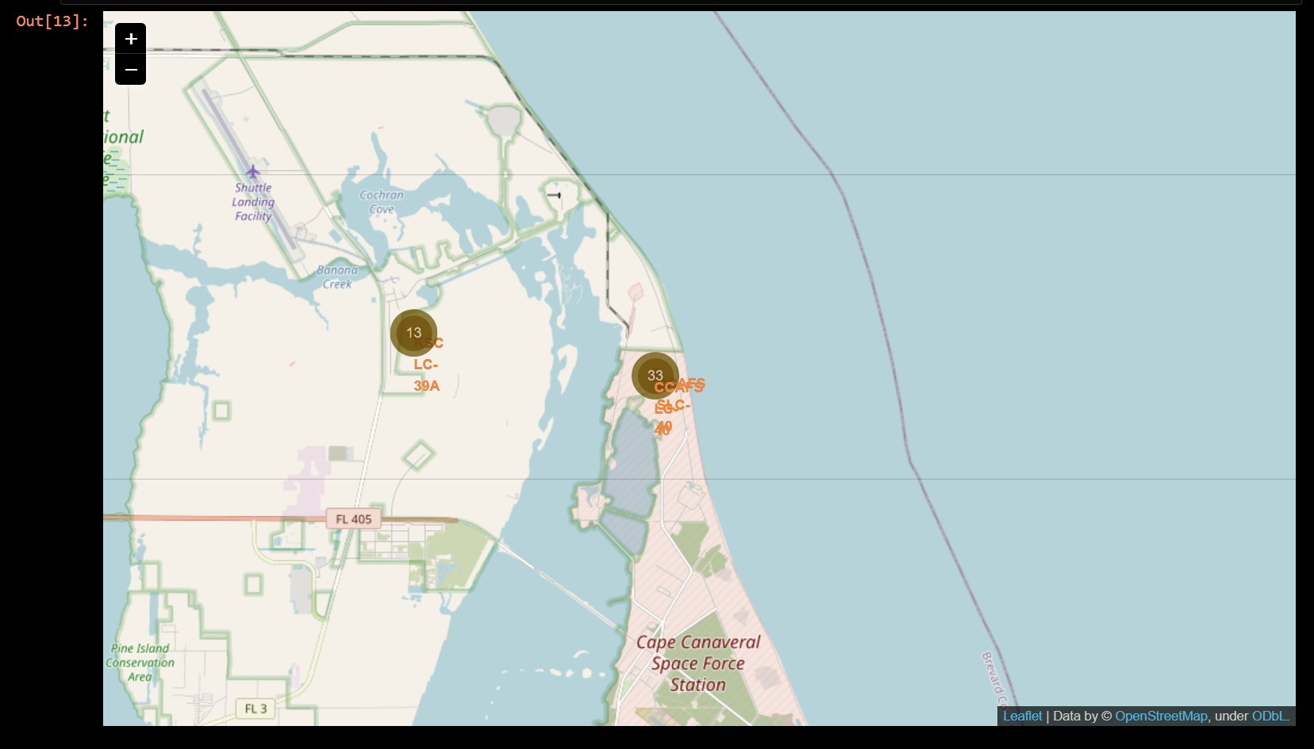
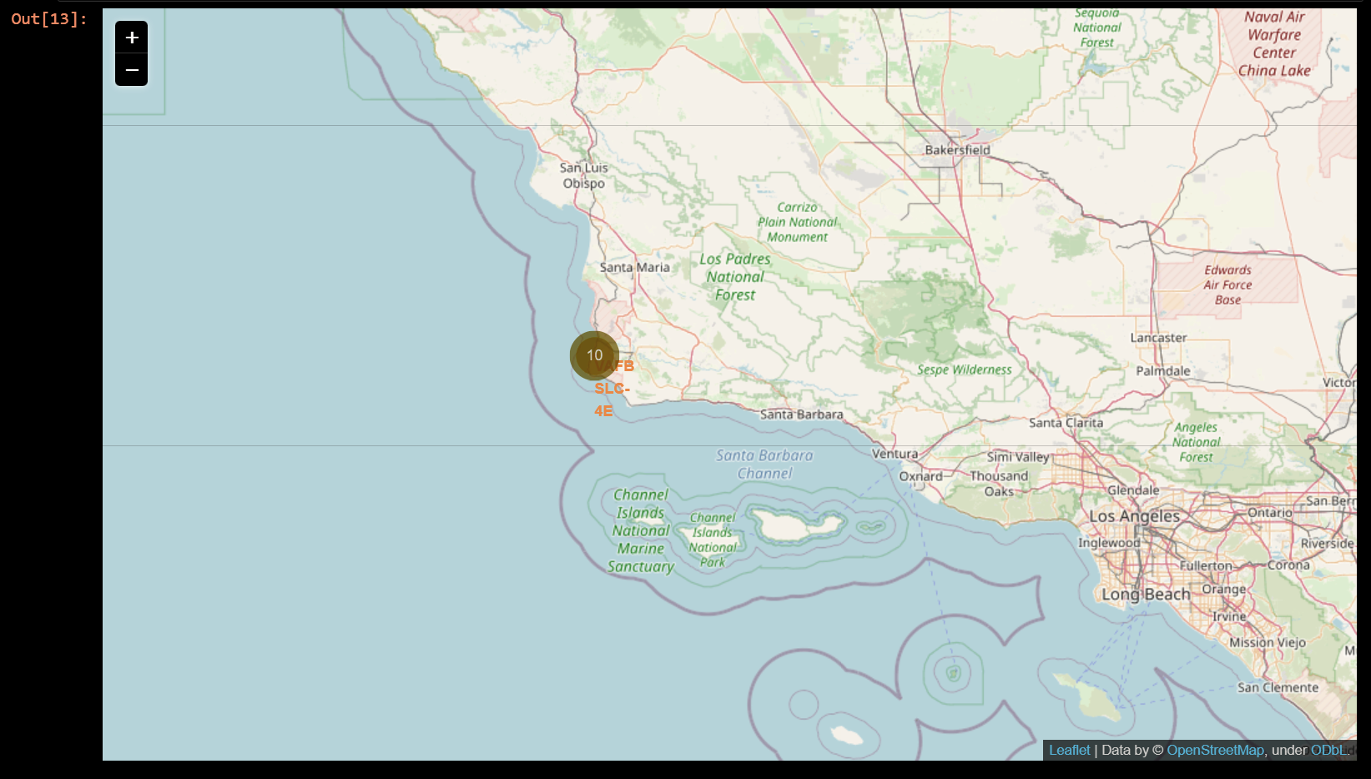
Site launch outcomes
Displaying site launch outcomes:

Slide 37
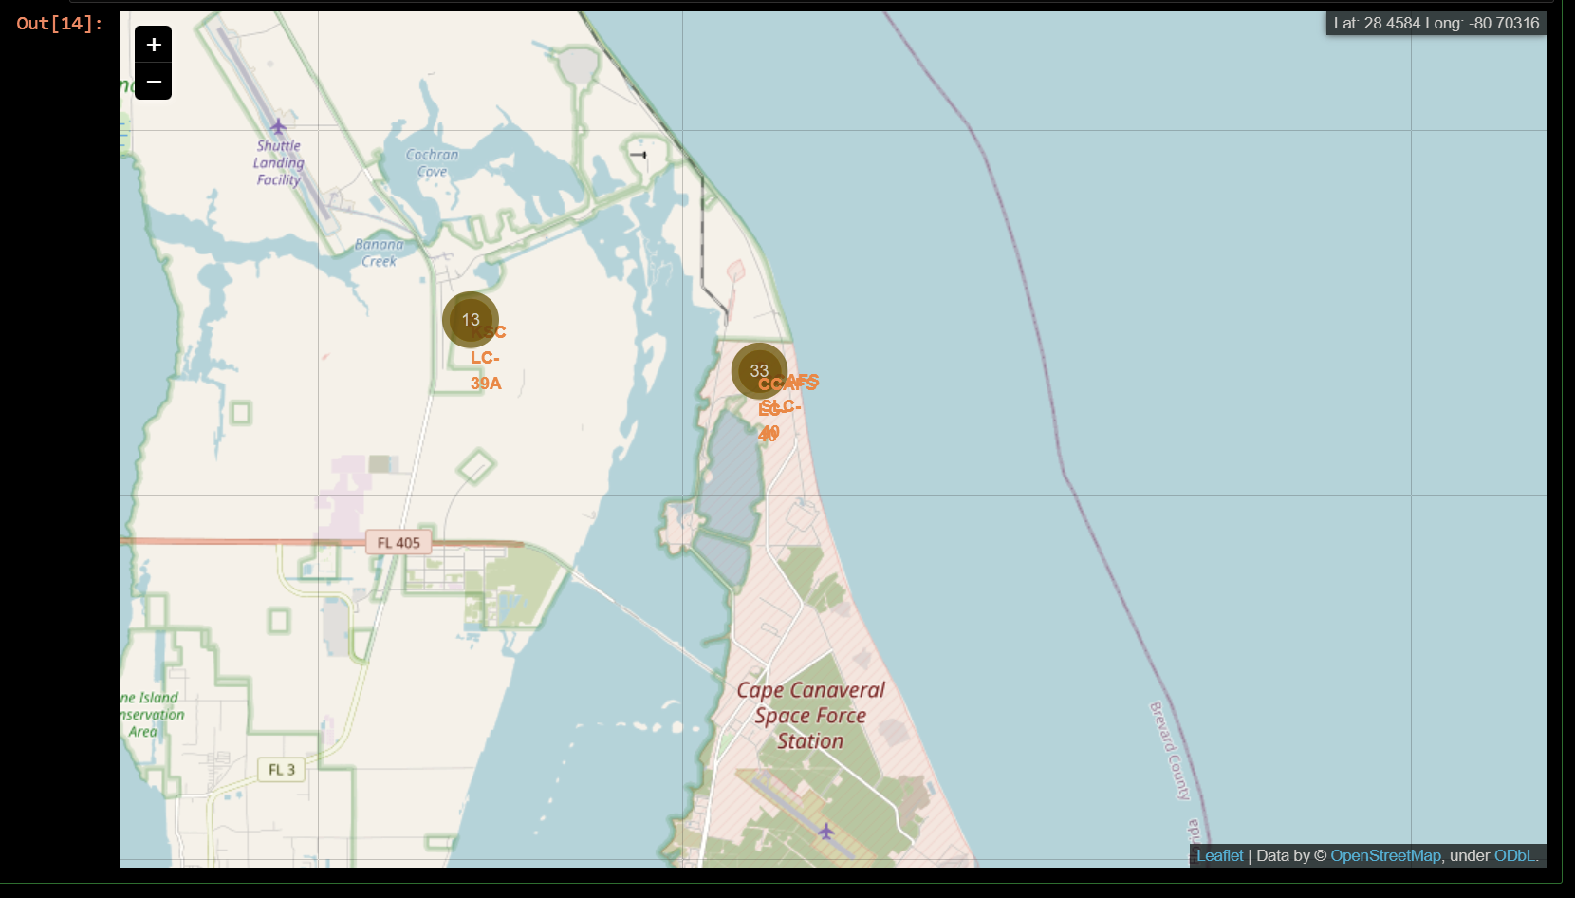
Proximity of launch sites

Slide 38

Section 4

Slide 39
Dashboard results
Unable to generate dashboard results, please find code in Appendix below

Slide 40
Dashboard results
Unable to generate dashboard results, please find code in Appendix below

Slide 41
Dashboard results
Unable to generate dashboard results, please find code in Appendix below

Slide 42

Section 5

Slide 43
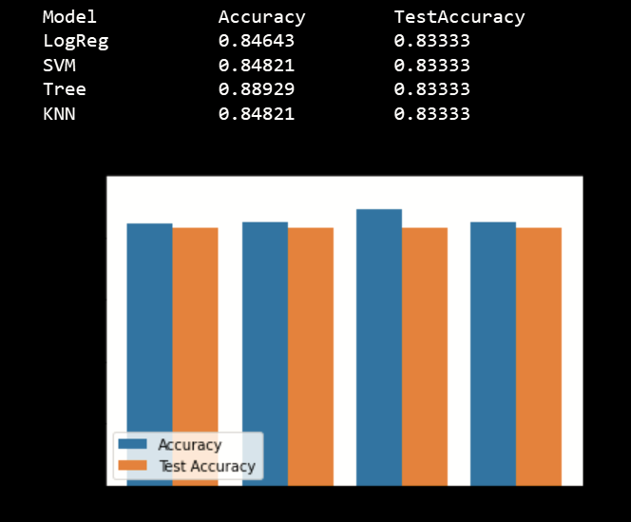
Classification Accuracy
Different models were evaluated, and their accuracies are shown on the right. The accuracy of a decision tree performs the best.

Slide 44
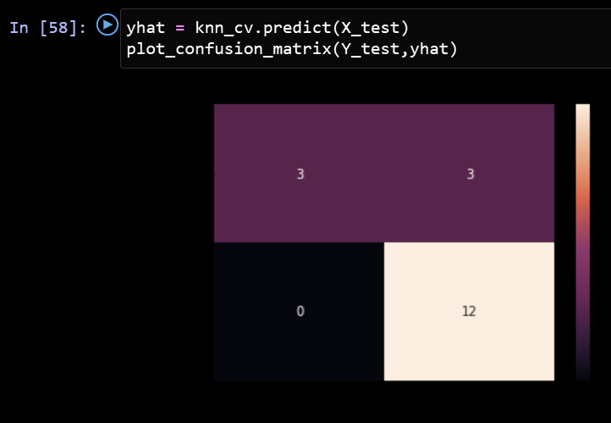
Confusion Matrix
Confusion matrix of decision tree

Slide 45
Conclusions
Different sources of data were analyzed, which helped support model develop and discovering conclusions about the solution and problem.
The decision tree classifier predicted successful landings and can be used to increase revenue
Successful landing improves over time, along with the technology of launches and rockets

Slide 46
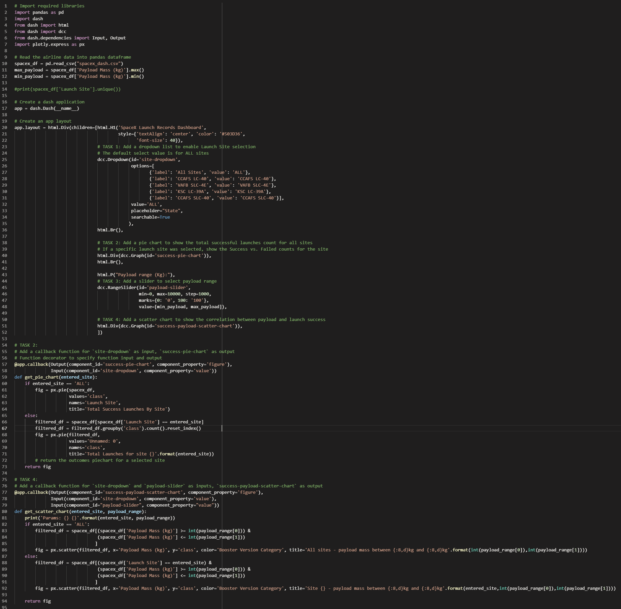
Appendix

Slide 47


